Slide 1


CAPSTONE PROJECT
PRESENTATION
INSURANCE CUSTOMER RESPONSE/CHURN PREDICTION
BY GAYATHRI PUGAZHENDI
Notes:
bring a suitable image

Slide 2

Vision & Mission
1.
Business Problem
My Project’s objective is to build a model that is suitable in predicting the churn patterns of the customer based on certain customer behavior like
the amount they pay as an Annual Premium
are they Previously Insured?
choice of policy selling channel
2.
Why work on this problem?
3.
What will be the future step?

Slide 3

BUSINESS PROBLEM
The problem statement is to figure out the response (yes or no) of vehicle insurance seeking customers to renew the policy or ignore the policy.
This depends on various factors and some important criteria(s).
The dataset contains the details of the individual customers, including age, gender, annual premium, vehicle age, vehicle damage, and so on. These are called as features.
There are 12 features in total and the one target variable which is ‘response/churn’.

Slide 4

STEPS OF THE PROJECT
1
2
3
4
5
6
Business Problem
Data collection
Data Preprocessing
Exploratory Data Analysis
Feature Selection
Model Building and Evaluation

Slide 5



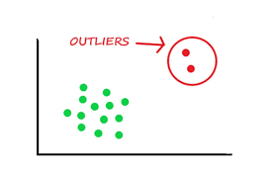
DATA PREPROCESSING AND ENCODING
Ordinal Encoding- Vehicle Age (>2 years, 1-2 years, <1 year)
Mean Encoding- Policy Sales channel
One hot Encoding- Gender and vehicle damage

Slide 6
FEATURE IMPORTANCE
Multi-collinearity Check
VIF quantifies how much a feature is linearly related to other features.
A VIF > 5 or 10 typically indicates high multicollinearity — and such features should be reviewed/dropped.
Got a VIF value of of less than 5 for all the 6 features.
SMOTE Technique (Oversampling)
SMOTE is a powerful data preprocessing technique used to handle class imbalance in classification problems, particularly when the minority class.
Many more examples of one class (NO = 0)
Very few examples of the target class (YES = 1)
Creates balanced datasets without simply duplicating existing data.
Class Weight balance
Predicting all as 0 gives 90% accuracy — but it completely misses churners.
Improved model accuracy in LR
Notes:
SMOTE - at data level
Class weights- use cases- fraud detection, churn prediction and medical diagnosis - at algorithmic level

Slide 7
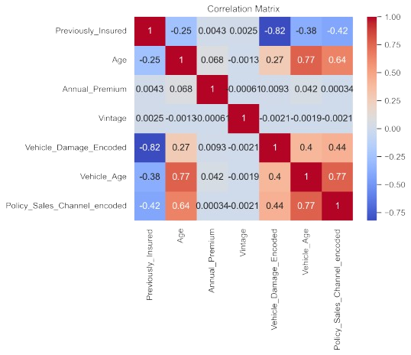
EDA-HEATMAP
Heatmap - based on the correlation between the numerical features, dropped vintage and driving license. There is no relationship between driving license and response, negative correlation between vintage and all the other features.
Heatmap - found multi-collinearity and resolved it using variance inflation factor(VIF).
Heatmap - Annual Premium does not correlate with any of the features, but still it is best to retain it for model training

Slide 8
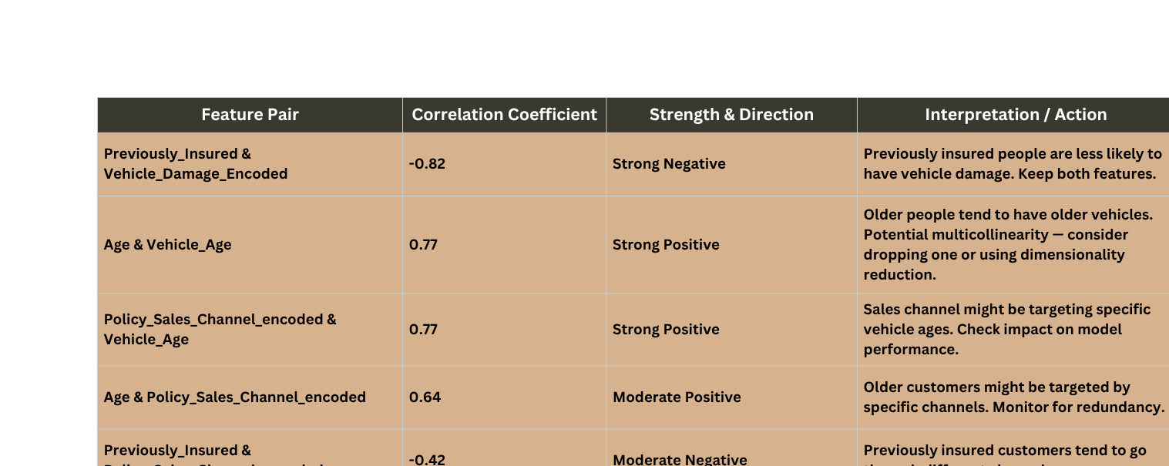
HEATMAP INTERPRETATION
Notes:
image for key insights from EDA

Slide 9
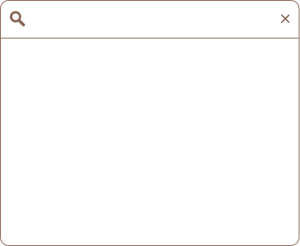
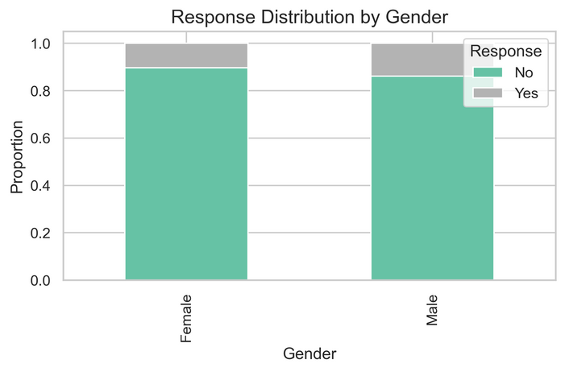
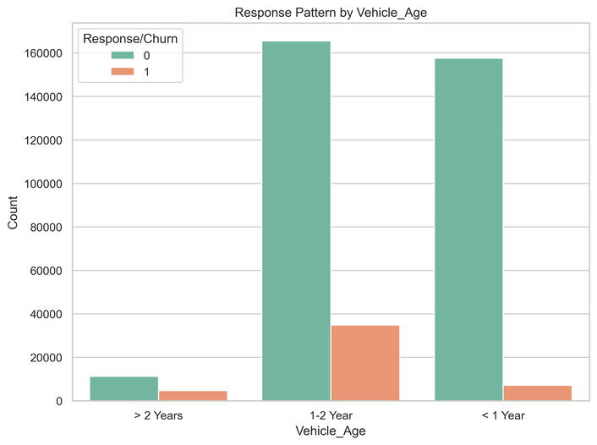
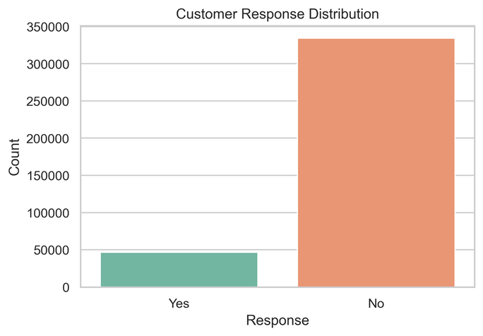
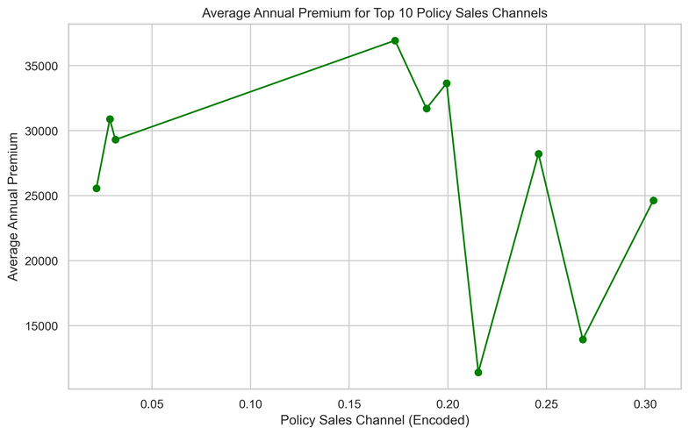
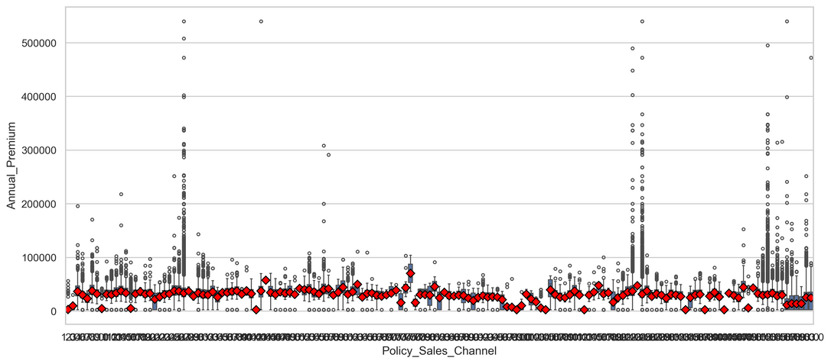
EDA
Gender vs Response
Vehicle age vs Response
Customer Response
Annual premium vs Policy channel
Vehicle age vs Response

Slide 10
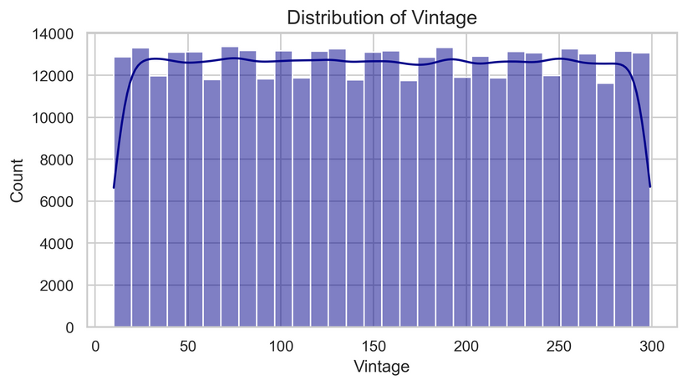
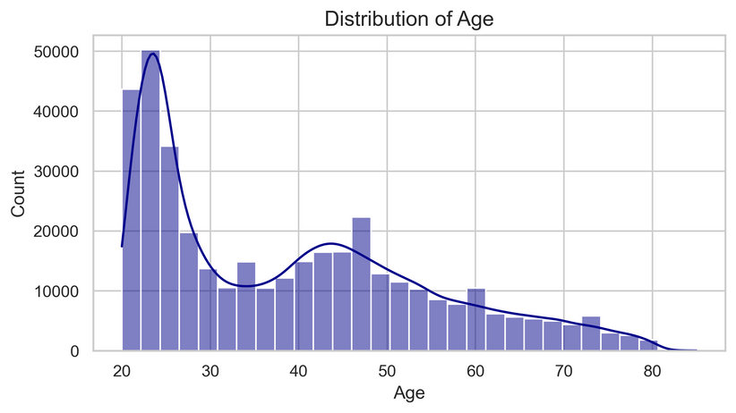
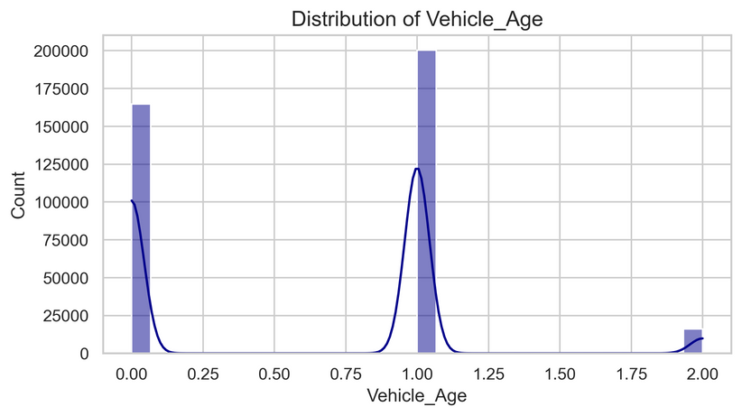
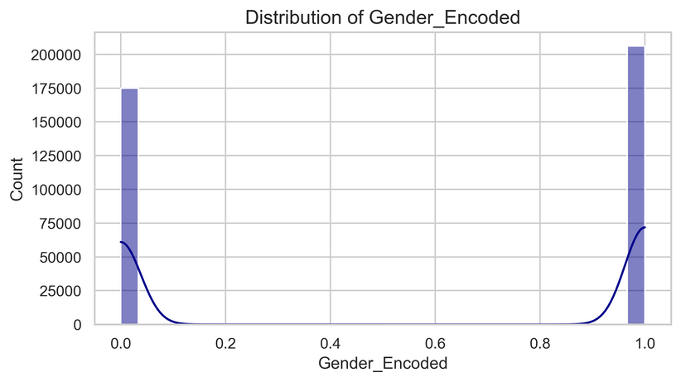
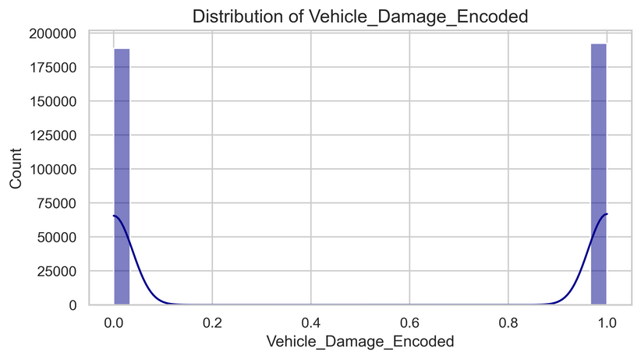
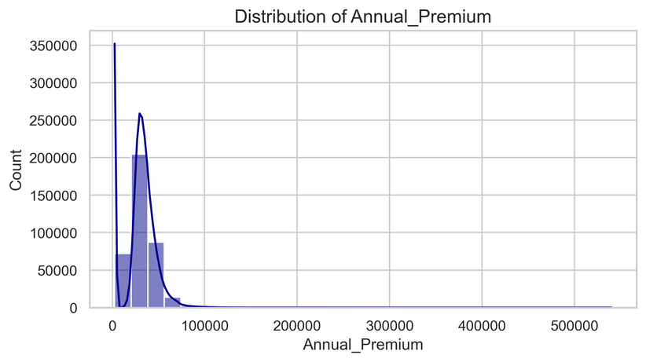
DISTRIBUTION OF NUMERICAL FEATURES
vintage
Age
vehicle Age
EDA
gender
vehiicle damage
Annual premium

Slide 11
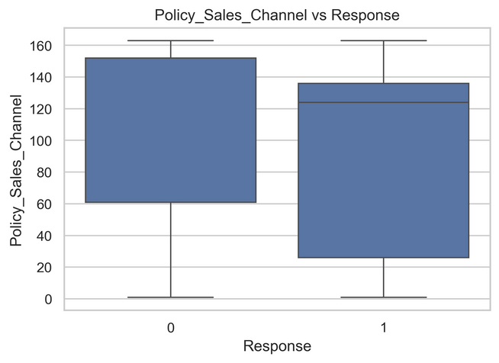
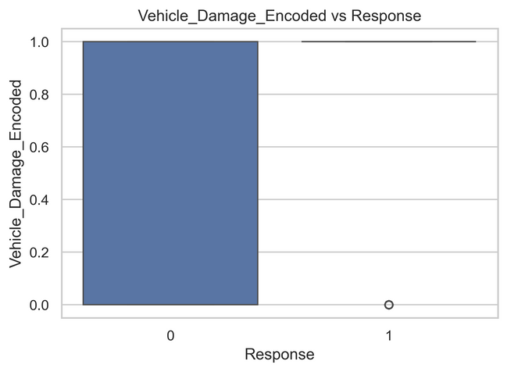
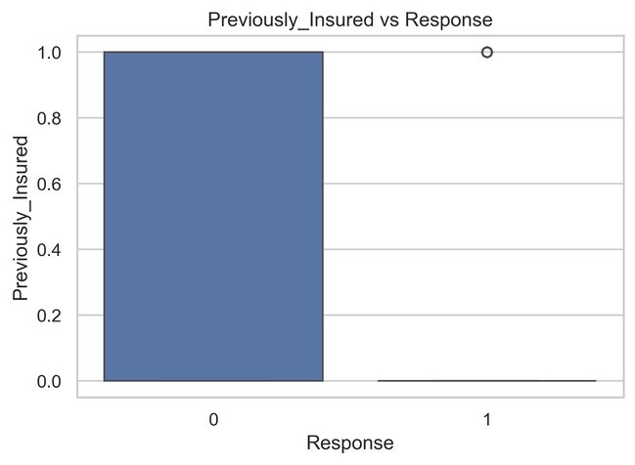
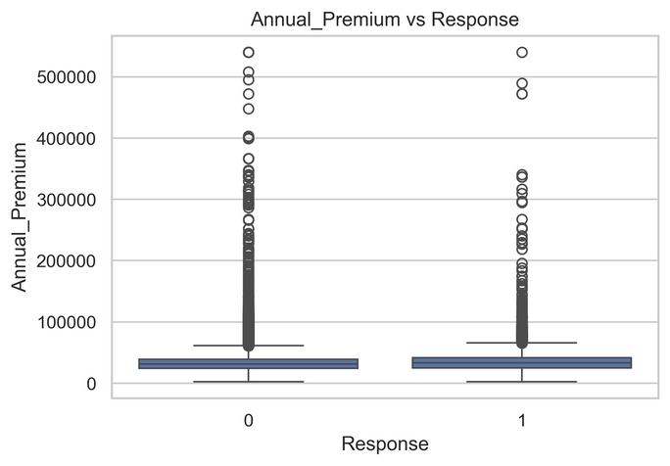
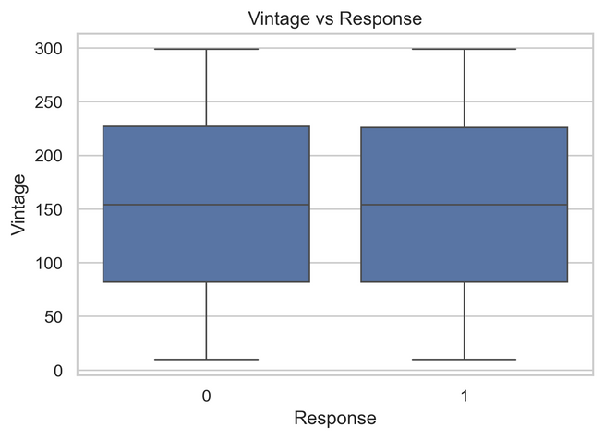
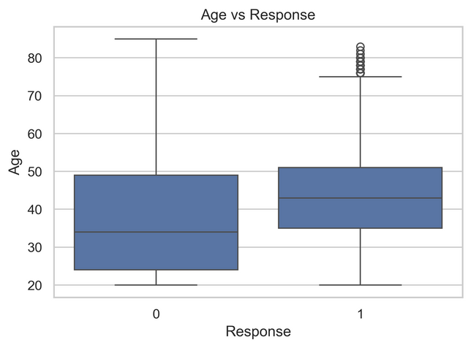
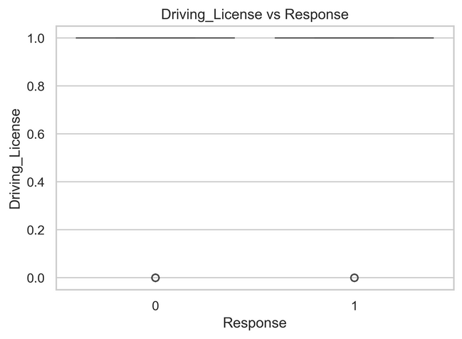
EDA
FEATURES VS TARGET
Policy Sales Channel
Vehicle Damage
Previously insured
Driving License
Annual Premium
Vintage
Customer Age

Slide 12

KEY FINDINGS FROM EDA
Premiums are right-skewed; a few customers have extremely high premiums.
Customers with vehicle damage reported tend to churn more
Understanding which channels are bringing in high or low premium customers. Outliers are at high premiums, some channels might be better at selling high-premium products, which is critical for sales performance tracking.
Previously insured customers are far less likely to churn.
Churn behavior varies slightly across age groups; young adults show moderate churn levels.
Customers with older vehicles (e.g., >2 Years) tend to churn more than others.
Notes:
image for key insights from EDA

Slide 13
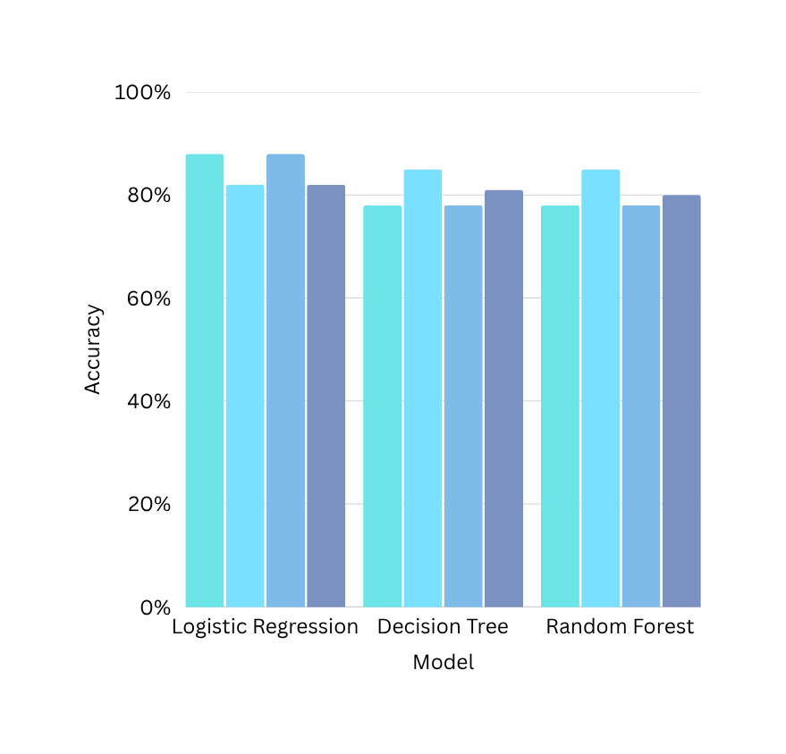
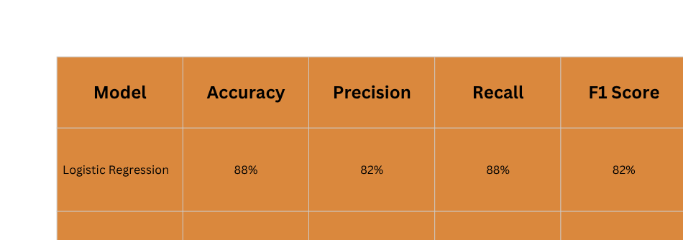
ML MODEL BUILDING
Notes:
image for key insights from EDA

Slide 14
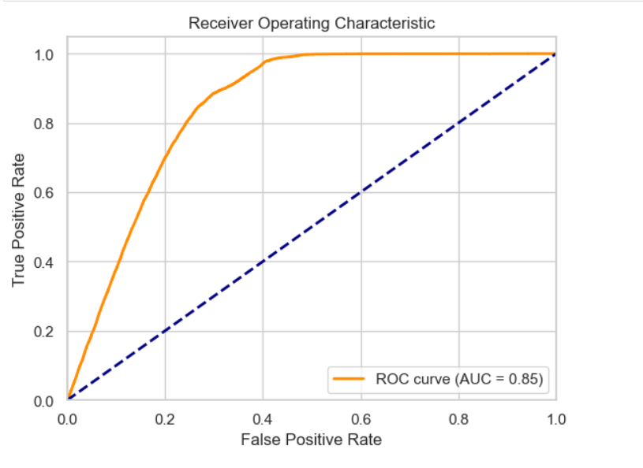
ROC-AUC CURVE OF LR

Slide 15
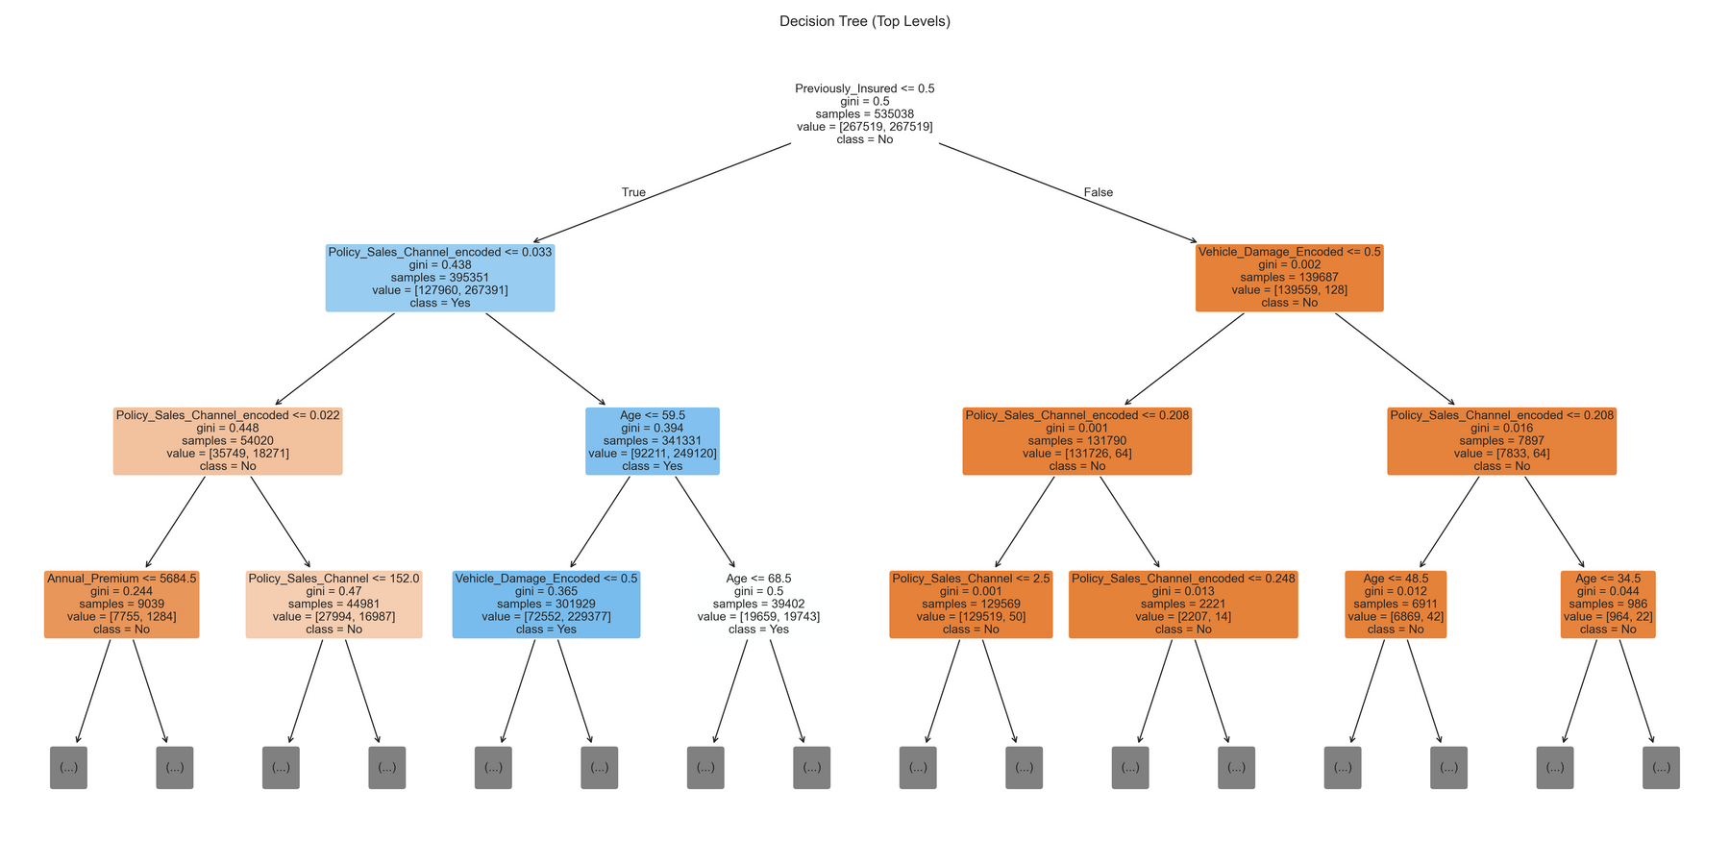
DECISION TREE
CLASSIFIER
Previously_Insured is a very strong feature — it's used as the root node.
Vehicle_Damage_Encoded, Policy_Sales_Channel_encoded, Age, and Annual_Premium are also key split features.
The tree helps you understand which combinations of features lead to different outcomes.
Gini values close to 0 mean confident classifications; high Gini means mixed responses.

Slide 16
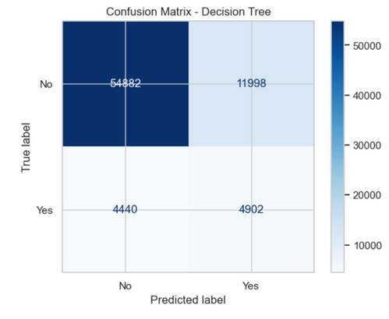
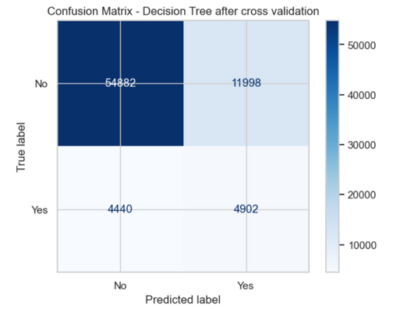
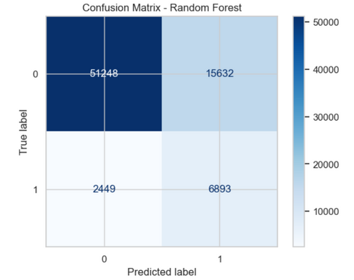
CONFUSION MATRIX
LR
DT
RF
Final best model- random Forest
Better recall or F1-score on minority classes
Higher model robustness
Better handling of imbalanced data

Slide 17
CONCLUSION
Random Forest Classifier has given an accuracy of 78% and is considered as a robust model to predict churn patterns.
From the feature importance analysis, we can come to a conclusion that Annual Premium, Previously Insured and Policy sales channel have drawn attention and are important for the model to predict.
After the training and testing, the model can be deployed for future purposes.

Slide 18

ANY QUESTION?

Slide 19

THANK YOU.

